Slide 1
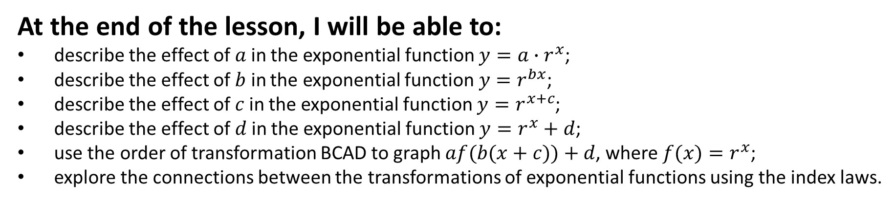
Learning Objective
I will be able to graph and describe the transformation of exponential function
Success Criteria
At the end of the lesson, I will be able to:
describe the effect of 𝑎 in the exponential function $y=a∙r^{x}$;
describe the effect of 𝑏 in the exponential function $y=r^{bx}$;
describe the effect of 𝑐 in the exponential function $y=r^{x+c}$;
describe the effect of 𝑑 in the exponential function $y=r^{x}+d$;
use the order of transformation BCAD to graph $af(b(x+c))+d$, where $f(x)=r^{x}$;
explore the connections between the transformations of exponential functions using the index laws.

Slide 2
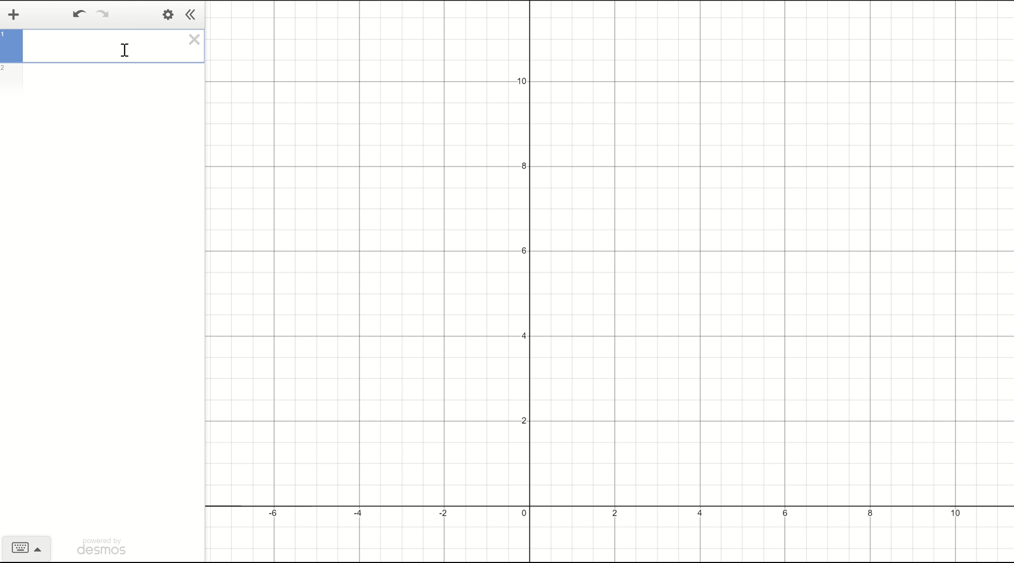
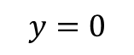
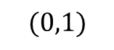
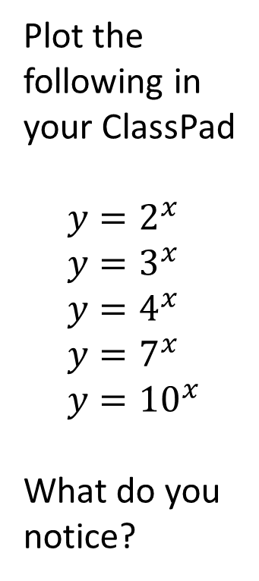
Concept development
Plot the following in your ClassPad
$$y=2^{x} \\ y=3^{x} \\ y=4^{x} \\ y=7^{x} \\ y={10}^{x}$$
What do you notice?
$$(0,1)$$
$$y=0$$

Slide 3
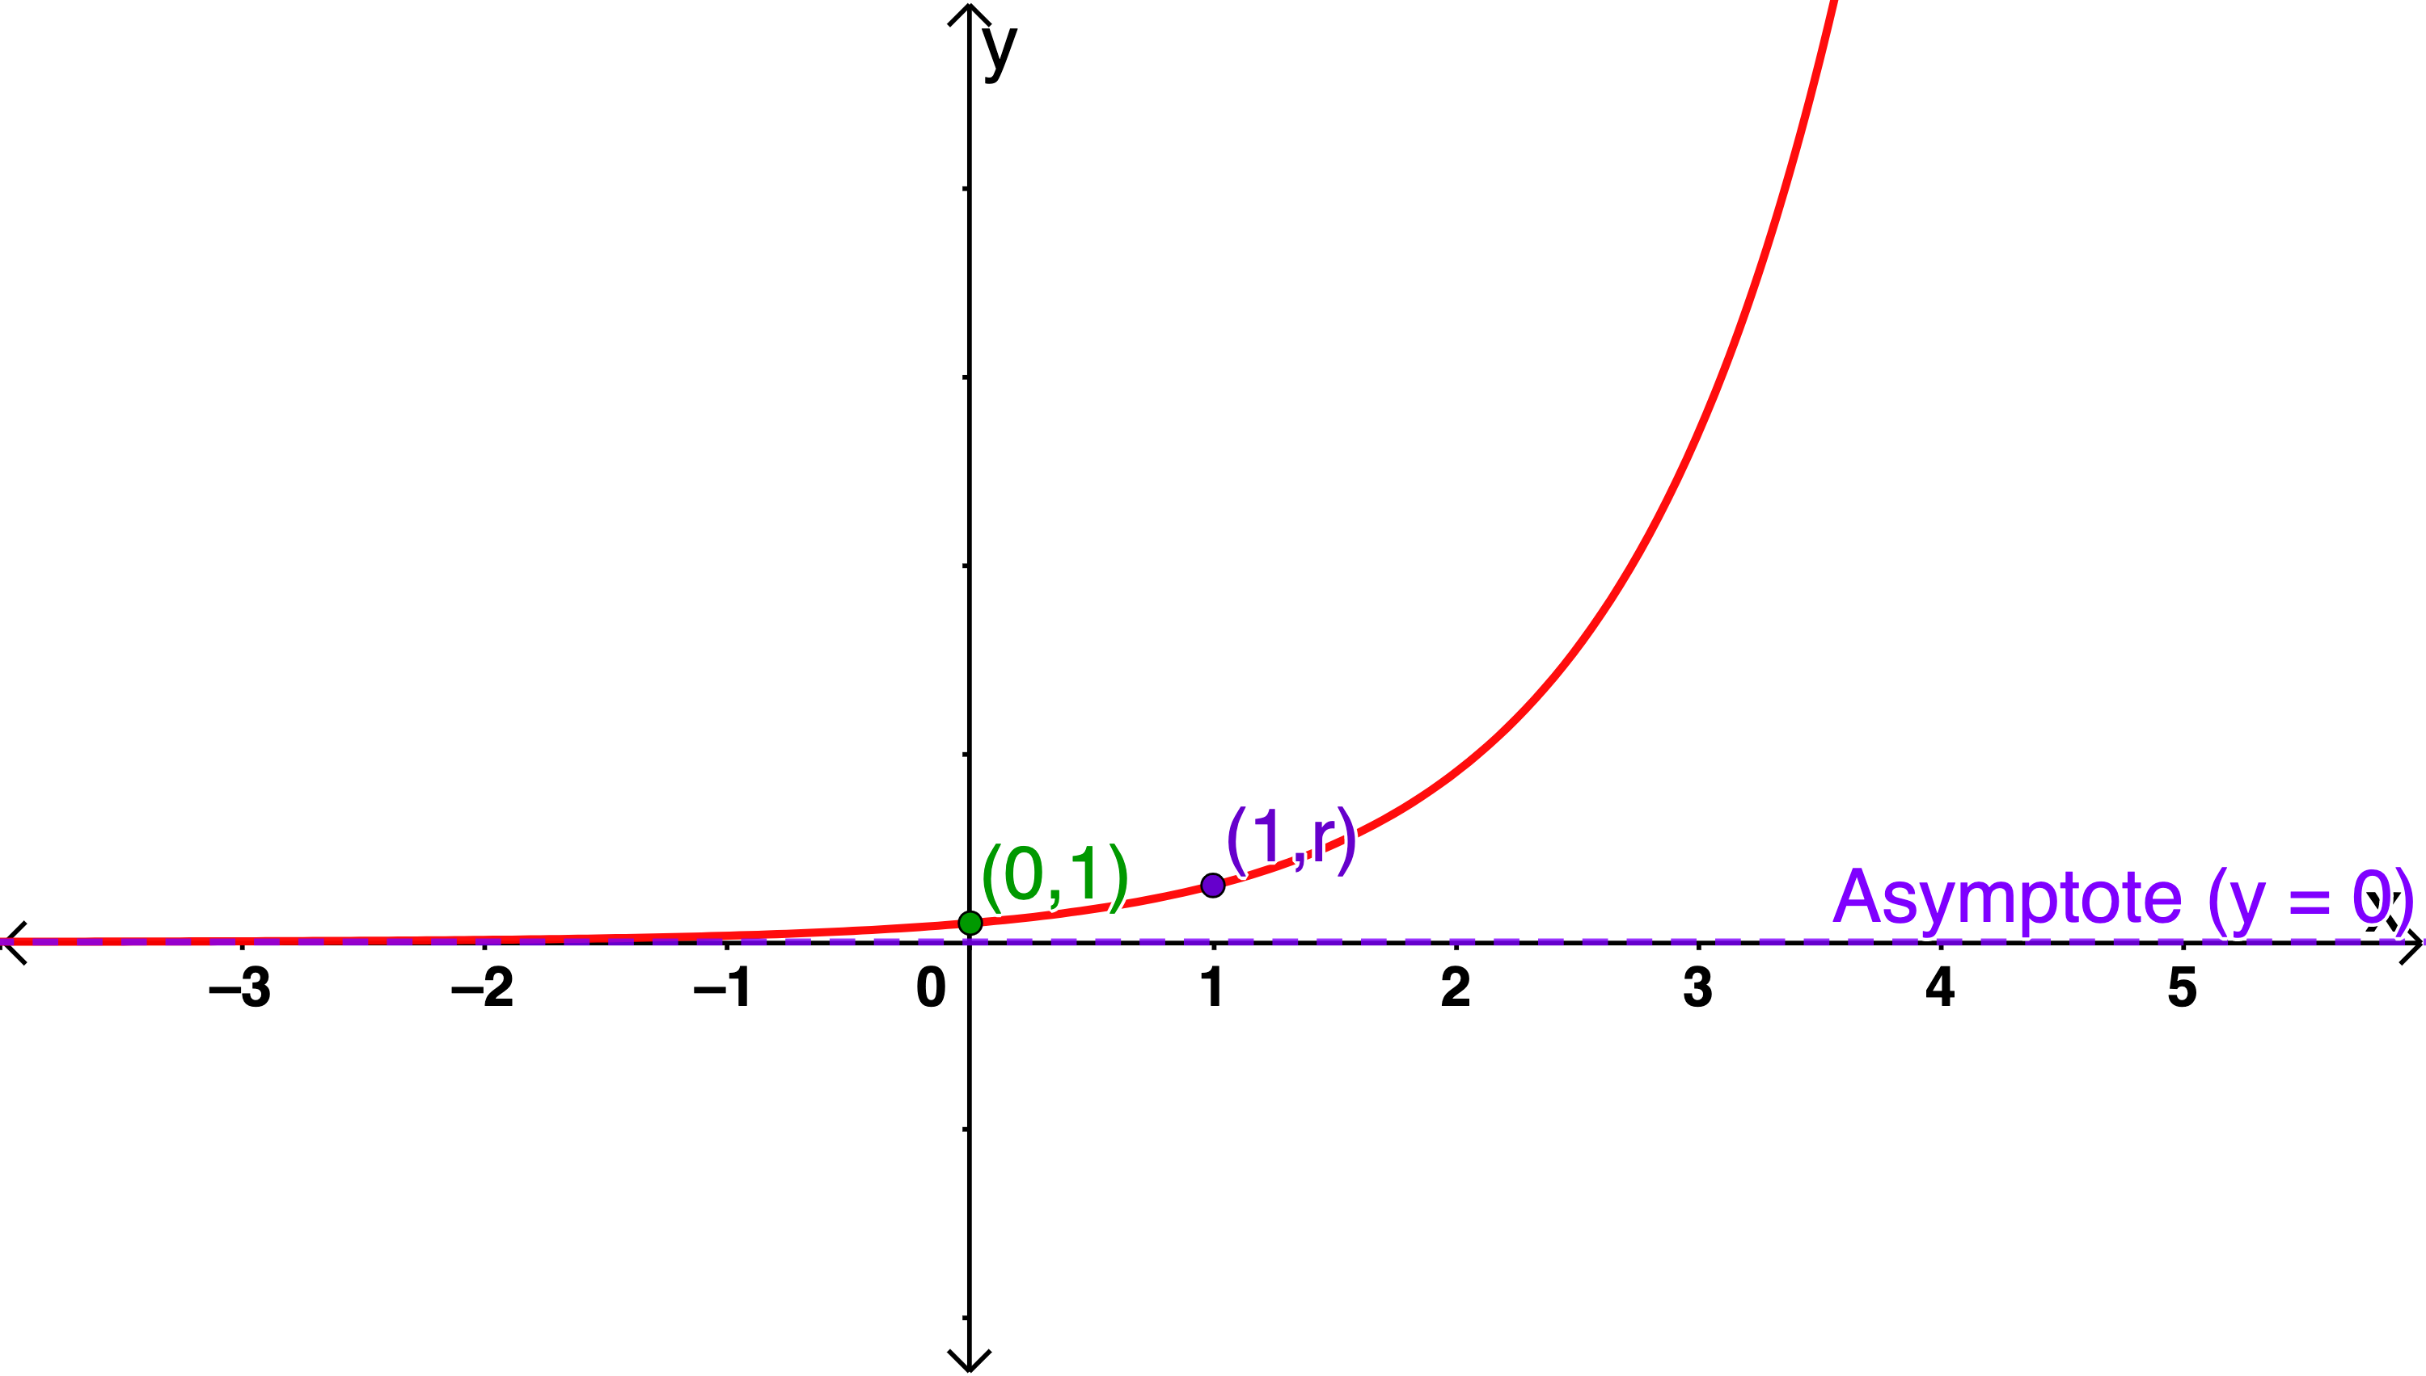
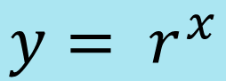

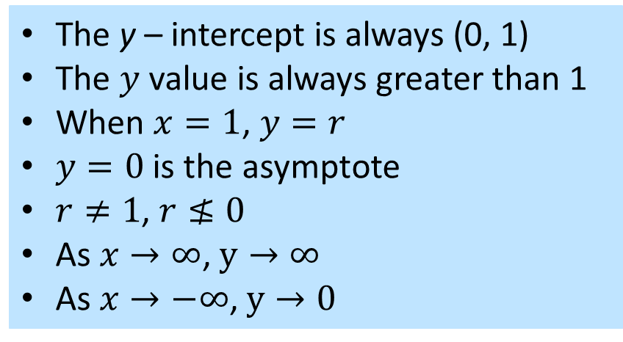
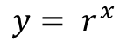
Concept development
$$y= r^{x}$$
$$y= r^{x}$$
$$where a=1$$
The y – intercept is always (0, 1)
The $y$ value is always greater than 1
When $x=1$, $y=r$
$y=0$ is the asymptote
$r≠1$, $r≰0$
As $x→∞$, $y→∞$
As $x→−∞$, $y→0$

Slide 4
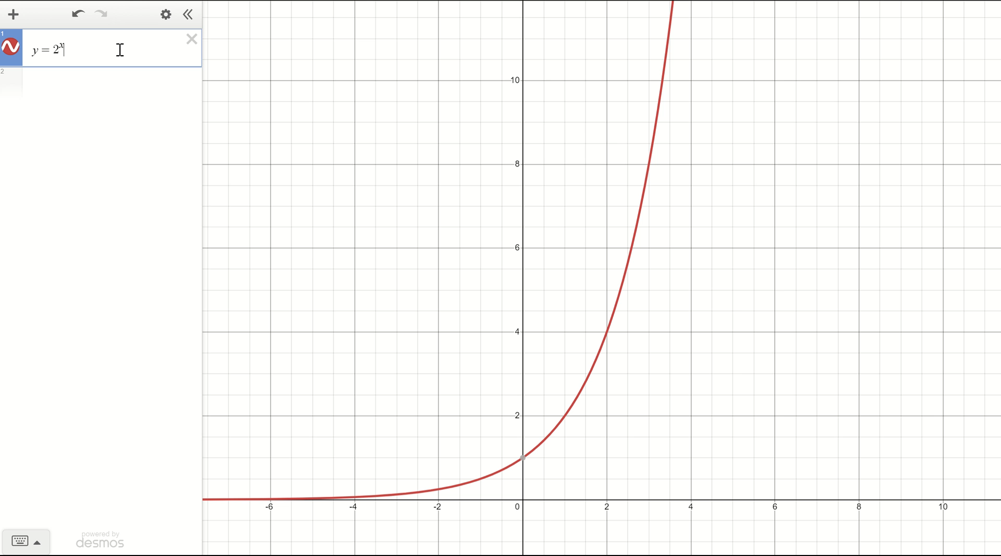
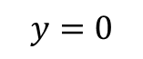
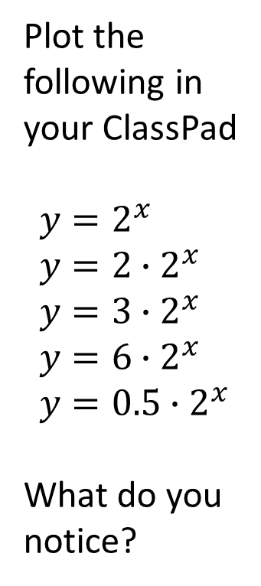
Concept development
Plot the following in your ClassPad
$$y=2^{x} \\ y=2∙2^{x} \\ y=3∙2^{x} \\ y=6∙2^{x} \\ y=0.5∙2^{x}$$
What do you notice?
$$y=0$$

Slide 5
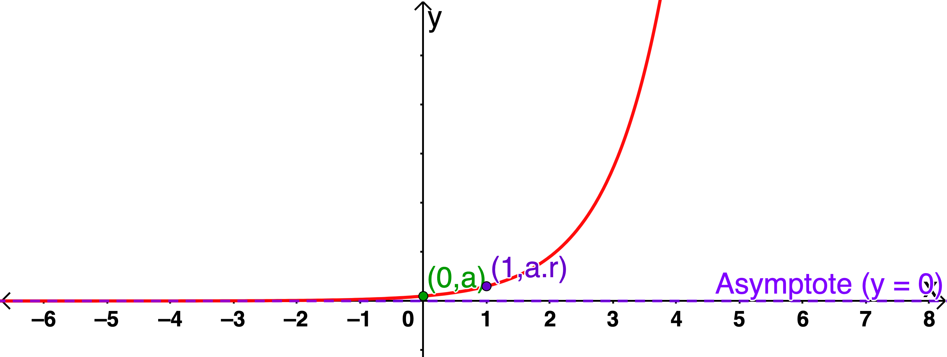
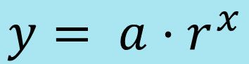
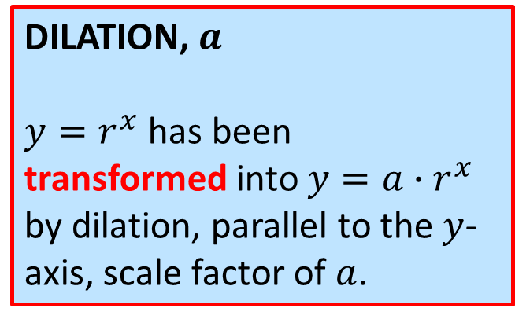
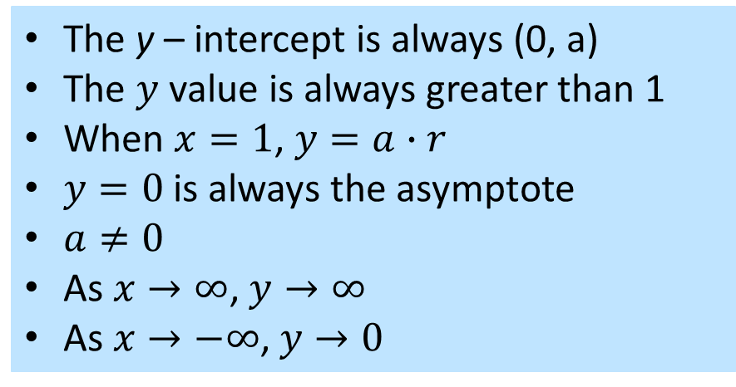
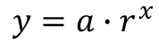
Concept development
$$y= {a⋅r}^{x}$$
$$y=a∙r^{x}$$
The y – intercept is always (0, a)
The $y$ value is always greater than 1
When $x=1$, $y=a∙r$
$y=0$ is always the asymptote
$a≠0$
As $x→∞$, $y→∞$
As $x→−∞$, $y→0$
DILATION, $a$
$y=r^{x}$ has been transformed into $y=a∙r^{x}$ by dilation, parallel to the $y$-axis, scale factor of $a$.

Slide 6
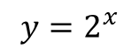

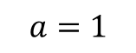
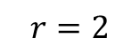
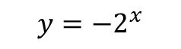
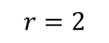
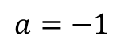
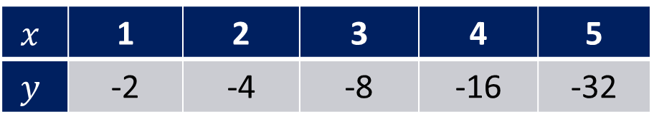
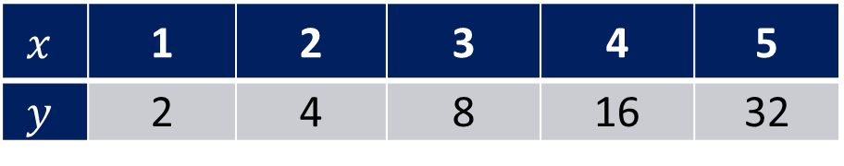
$$y=a∙r^{x}$$
Concept development
Compare the tables of value below. For each relationship, determine the rule and plot it using your ClassPad.
$$r=2$$
$$x$$ | 1 | 2 | 3 | 4 | 5
$$y$$ | 2 | 4 | 8 | 16 | 32
$$a=1$$
$$y=2^{x}$$
$$x$$ | 1 | 2 | 3 | 4 | 5
$$y$$ | -2 | -4 | -8 | -16 | -32
$$r=2$$
$$a=−1$$
$$y=−2^{x}$$
What do you notice about the transformation of the first to the second graph?

Slide 7
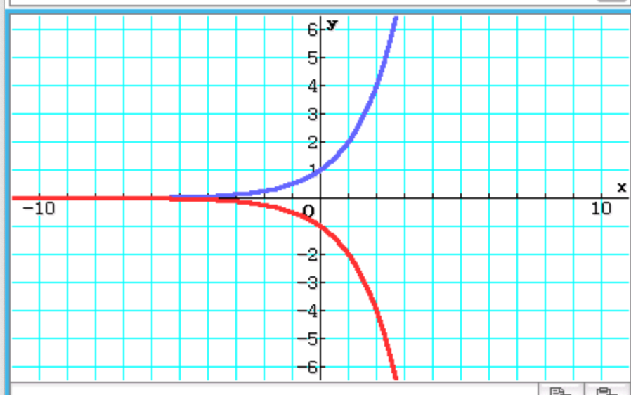
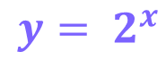
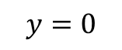
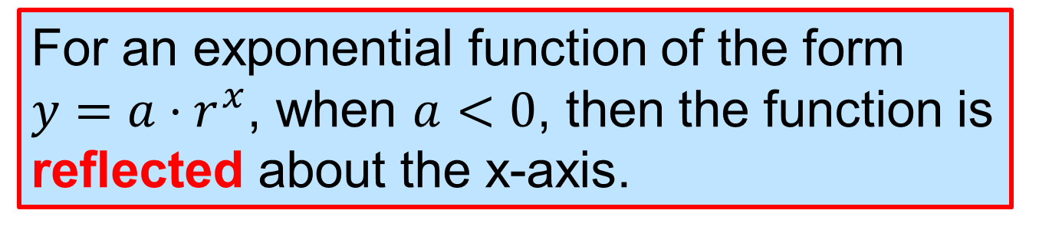
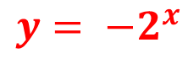
$$y= 2^{x}$$
$$y=0$$
$$y= {−2}^{x}$$
For an exponential function of the form $y=a⋅r^{x}$, when $a<0$, then the function is reflected about the x-axis.

Slide 8
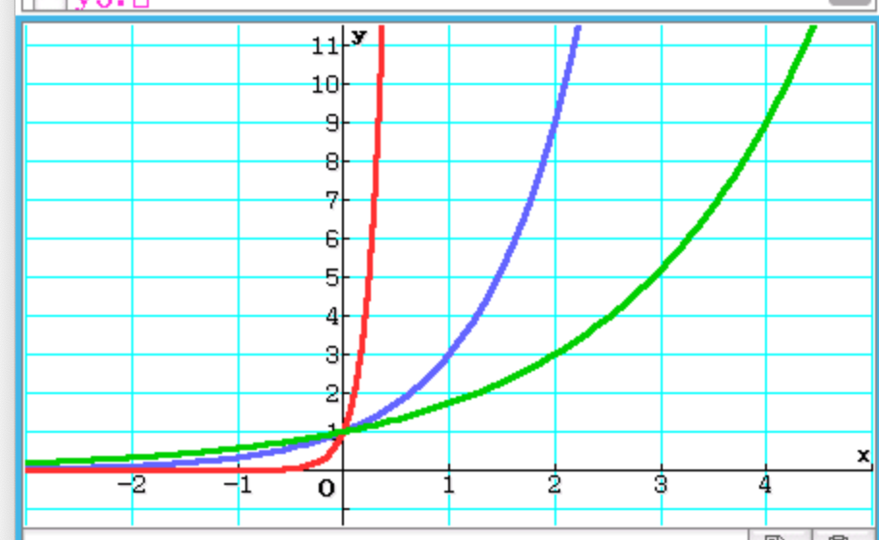
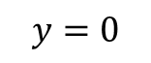

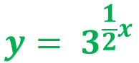
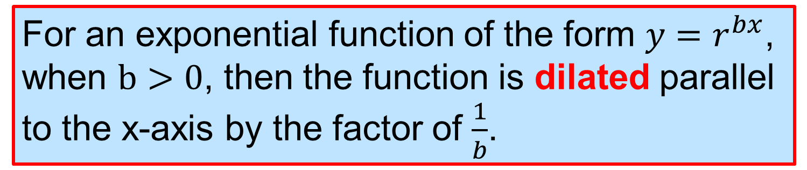
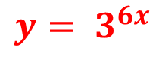
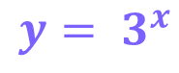
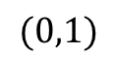
Concept development
$$y= 3^{6x}$$
$$y= 3^{x}$$
Use your classpad to plot
$y= 3^{x}$
$y= 3^{6x}$
$y= 3^{\frac{1}{2}x}$
$$y= 3^{\frac{1}{2}x}$$
$$(0,1)$$
$$y=0$$
For an exponential function of the form $y=r^{bx}$, when $b>0$, then the function is dilated parallel to the x-axis by the factor of $\frac{1}{b}$.

Slide 9
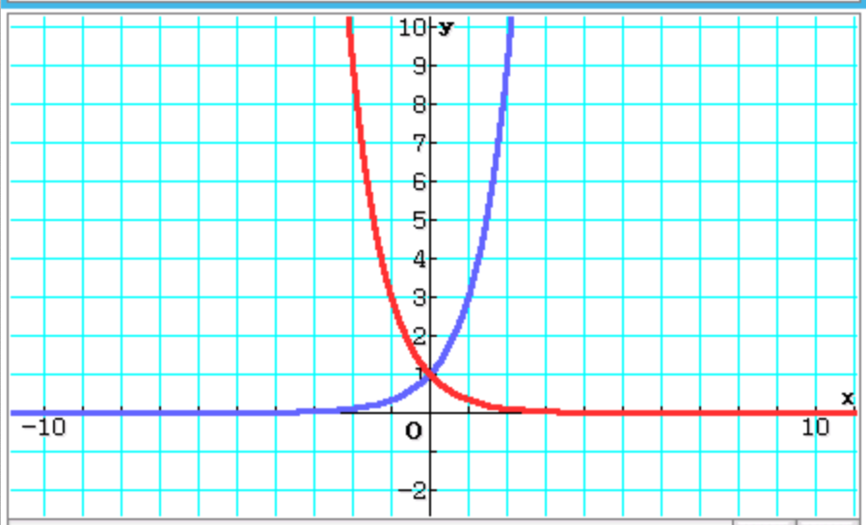
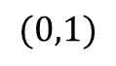
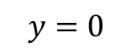

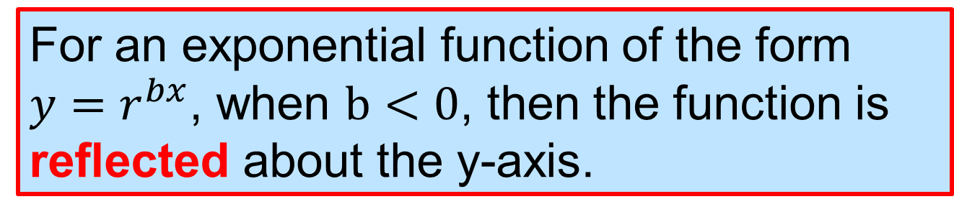
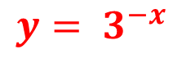
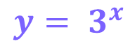
Concept development
Use your classpad to plot
$y= 3^{x}$
$y= 3^{−x}$
$$y= 3^{x}$$
$$y= 3^{−x}$$
$$(0,1)$$
$$y=0$$
For an exponential function of the form $y=r^{bx}$, when $b<0$, then the function is reflected about the y-axis.

Slide 10
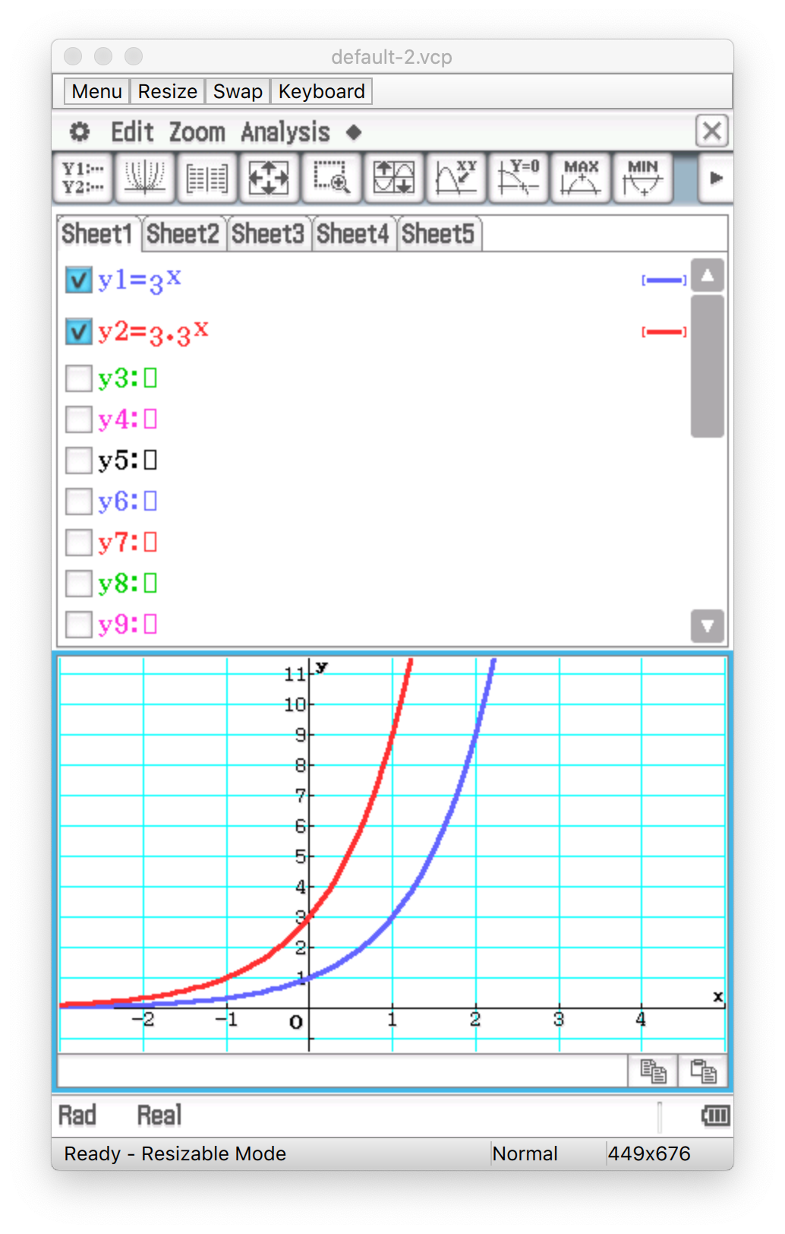
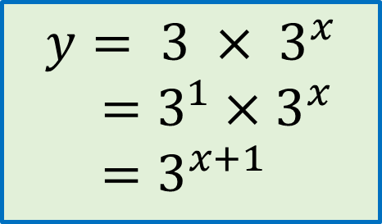
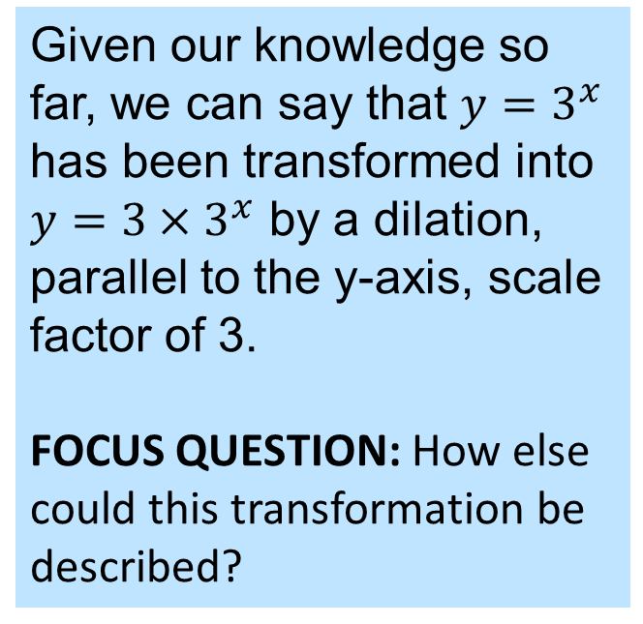
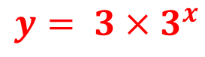
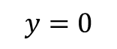
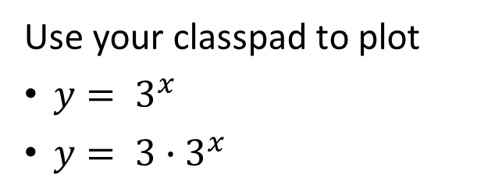
Concept development
Use your classpad to plot
$y= 3^{x}$
$y= {3∙3}^{x}$
$$y= 3^{x}$$
Given our knowledge so far, we can say that $y=3^{x}$ has been transformed into $y=3×3^{x}$ by a dilation, parallel to the y-axis, scale factor of 3.
FOCUS QUESTION: How else could this transformation be described?
$$y= {3×3}^{x}$$
$$y=0$$
$$y= {3 × 3}^{x}$$
$=3^{1}×3^{x}$
$=3^{x+1}$

Slide 11
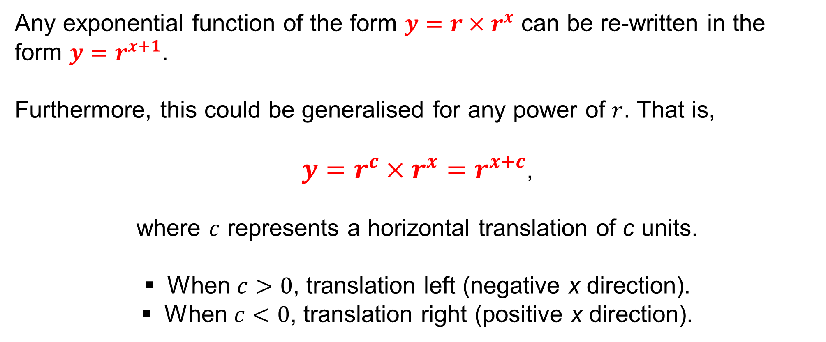
Concept development
Any exponential function of the form $y=r×r^{x}$ can be re-written in the form $y=r^{x+1}$.
Furthermore, this could be generalised for any power of $r$. That is,
$y=r^{c}×r^{x}=r^{x+c}$,
where $c$ represents a horizontal translation of c units.
When $c>0$, translation left (negative x direction).
When $c<0$, translation right (positive x direction).

Slide 12






Concept development
Consider the two tables of values of below, representing two different but related exponential functions. Determine the transformation of the first table to the second.
Determine the equation of the first and second table.
$$x$$ | 1 | 2 | 3 | 4 | 5
$$y$$ | 2 | 4 | 8 | 16 | 32
$$r=2$$
$$a=1$$
$$y=2^{x}$$
$$x$$ | 1 | 2 | 3 | 4 | 5
$$y$$ | 6 | 8 | 12 | 20 | 36
$$y=2^{x}+4$$

Slide 13




Concept development
$$y=4$$
$$y=0$$
For an exponential function of the form $y=a⋅r^{x}+d$, the function is translated vertically up/down by d units

Slide 14

Concept development
Given the exponential function of the form $y=r^{x}$, the function transformation $y=r^{x}+d$ represents a vertical translation, of $d$ units.
When $d>0$, translation up (positive y direction).
When $d<0$, translation down (negative y direction).
NOTE 1: Given that the vertical translation shifts the whole function up or down, $d$ units, it also translates the horizontal asymptote.
That is, the function $y=r^{x}$ has a horizontal asymptote with the equation $y=0$. After a vertical translation such that $y=r^{x}+d$, the horizontal asymptote is at $y=d$.
NOTE 2: An exponential table of values that has a vertical translation will have a common ratio in the first differences. This is because a vertical translation is just a ‘linear’ transformation up or down.

Slide 15
Independent Practice
Complete Cambridge Ex 14D and Worksheet

